Slide 1
In State: A Design Pattern
James Goodrich

Slide 2
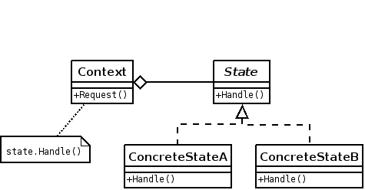
You Might Like: SDP

Slide 3
You Might Not: SDP
Image editing programs make the mouse wear many hats, translating into complex state designs and implementations.
Touch-based devices field similar concerns.

Slide 4
The State Driver (C#.2008)
class Program
{
static void Main(string[] args)
{
Context stateGreeting = new Context();
stateGreeting.greet("SC");
stateGreeting.greet("AL");
stateGreeting.greet("GA");
stateGreeting.greet("FL");
stateGreeting.greet("NC");
Console.Write("Press <Enter> to close.");
Console.ReadLine();
}
}

Slide 5
Running in the Background
interface State
{
void greet(Context c, string state);
}
class Context
{
private State s;
public Context()
{
s = new StateOne();
}
public void setState(State newState)
{
s = newState;
}
public void greet(string state)
{
s.greet(this, state);
}
}
class StateOne : State
{
public void greet(Context c, string state)
{
Console.WriteLine(state + ": Hello.");
c.setState(new StateTwo());
}
}
class StateTwo : State
{
public void greet(Context c, string state)
{
Console.WriteLine(state + ": Sup?");
c.setState(new StateOne());
}
}

Slide 6
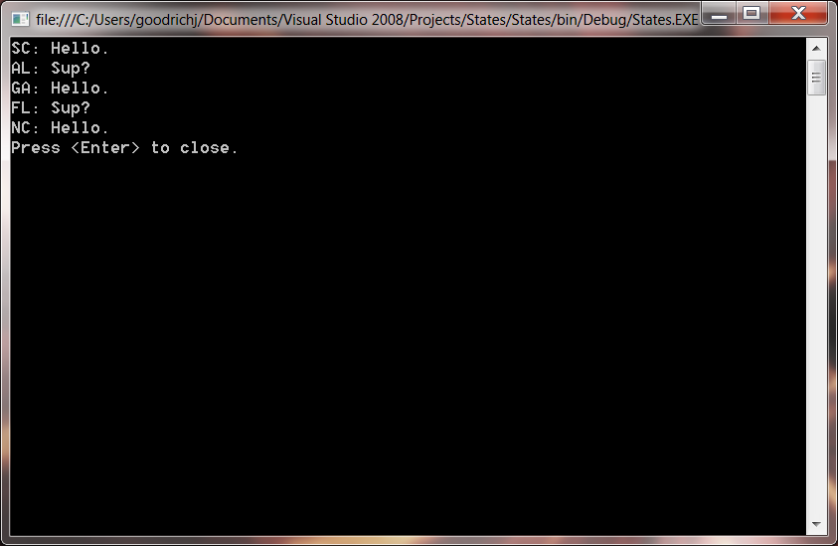
Survey Says…

